Slide 1
Motivation: risk management of portfolios (portfolio surgery)

Slide 2
Stock P&L

Slide 3
Equity portfolio P&L

Slide 4
Lesson plan
Option Spreads
Payoff versus profit and loss (P&L) diagrams
Spreads as max expected profit profiles
Risk management of portfolios!
Pricing bounds.

Slide 5
Option Spreads
Bull
Bear
Butterfly
Straddle

Slide 6
A single call option: Payoff at expiration

Slide 7
A single call option: P&L at expiration (price of call is $2).

Slide 8
Payoff vs. p&l

Slide 9
Quiz: Slope

Slide 10
Bull Spread
Slope=0
Slope=1
Slope=0

Slide 11
Quiz; Changing slopes
Suppose you buy one call…
What is the slope of the upward sloping segment?
Suppose you buy 14 calls…
What happens to the slopes when you buy one call with strike 15 and buy one call with strike 25, same expiration?
Etc.

Slide 12
Quiz: butterfly
Slope=1
Slope= -1
Slope=0
Slope=0

Slide 13
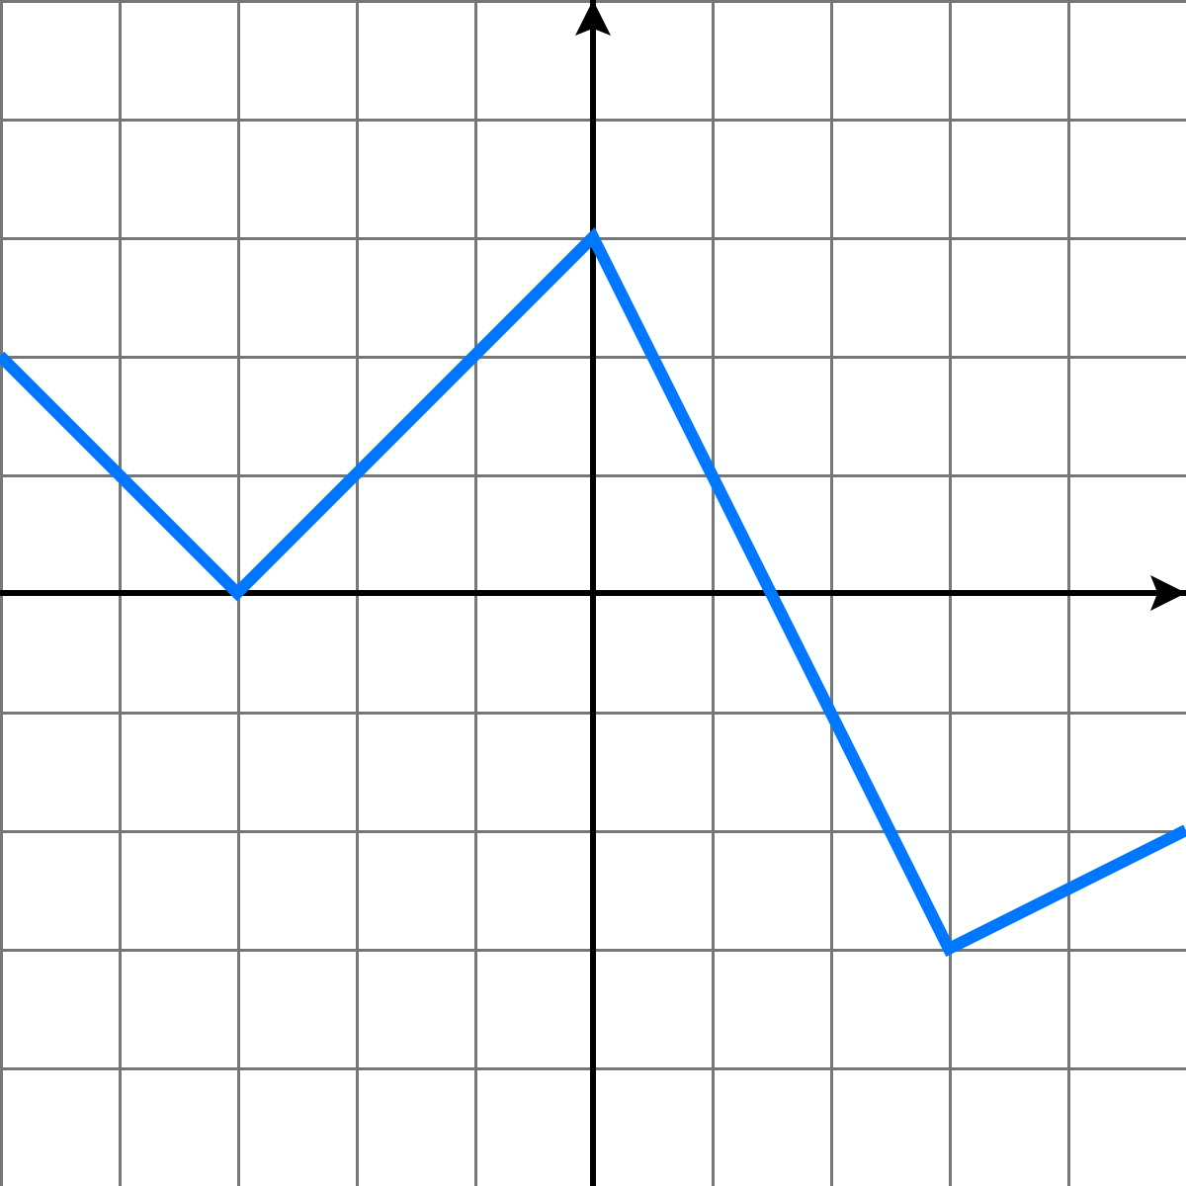
Any shape! Calculus of slopes
Slope=-20
Slope=20
Slope=-40
20
50
80
Slope=10

Slide 14
Quiz: Calculus of slopes

Slide 15
Bear Spread
Short 1 put strike 10
Slope= -1
Long 1 put strike 20

Slide 16
Risk management: portfolio surgery.

Slide 17
Covered Call Position

Slide 18
Covered call position
A covered call position is obtained as:
Long stock
Short call option.

Slide 19
Partial covered calls..
Long 1 stock short 1 call option (Covered call)
Long 100 stocks short 100 call options (Covered call portfolio)
Long 1000 stocks short 2000 call options (imperfect covered call)
Long 1000 stocks short 800 call positions (imperfect covered call)

Slide 20
Probabilistic analysis

Slide 21
Probabilistic Analysis (stocks and bonds)
You have $50,000 to invest. Stock XYZ sells at $20 per share today.
In addition, a 6-month riskless zero-coupon bond with $100 face value sells for $90.
You have decided to stay with a long only portfolio. That is, there are no sell positions in stocks or bonds.

Slide 22
Probabilistic Analysis (stocks and bonds)
You consider three scenarios for the price of stock XYZ six months from today:
the price will be the same as today,
the price will go up to $40,
or drop to $12.
Your best estimate is that each of these scenarios is equally likely.
Determine the portfolio of stocks and the bond that maximize expected profit. Stay with long only positions in both stocks and bonds.

Slide 23
Probabilistic Analysis (with options!)
You have $50,000 to invest. Stock XYZ sells at $20 per share today.
In addition, a 6-month riskless zero-coupon bond with $100 face value sells for $90.
A European call option to buy a share of stock XYZ at $15 six months from today sells for $10.
A European call option to buy a share of stock XYZ at $20 six months from today sells for $6.
You can also raise additional funds which can be immediately invested, if desired, by selling call options with the above characteristics.
You have decided to limit the number of call options that you sell at most 6,000.

Slide 24
Probabilistic Analysis (with options!)
You consider three scenarios for the price of stock XYZ six months from today:
the price will be the same as today,
the price will go up to $40,
or drop to $12.
Your best estimate is that each of these scenarios is equally likely.
Determine the portfolio of stocks, bonds, and options that maximize the expected profit.

Slide 25
HW: Only options
Now do the same problem using only options of strikes $15, $20 and $25.
Assume that the prices of the options are $6, $5 and $10 (not in the same order!).

Slide 26
HW: Probabilistic Analysis
Use real data for say XLE (Energy SPDR sector)
Suppose you have $50,000 to invest.
Write down an educated guess for a trinomial tree for XLE.
Use actual market prices for three suitable options.
Calculate a portfolio of options and the stock that maximizes expected profit.

Slide 27
Pricing bounds for options

Slide 28
Quiz: Pricing bounds
Consider three strike prices K1, K2 and K3 in increasing order.
Which is more expensive, call(K1) or call(K2), all else equal?
Which is more expensive, put(K1) or put(K2), all else equal?
What is the relationship between the prices of call(K1), call(K2) and call(K3), all else equal?

